Slide 1
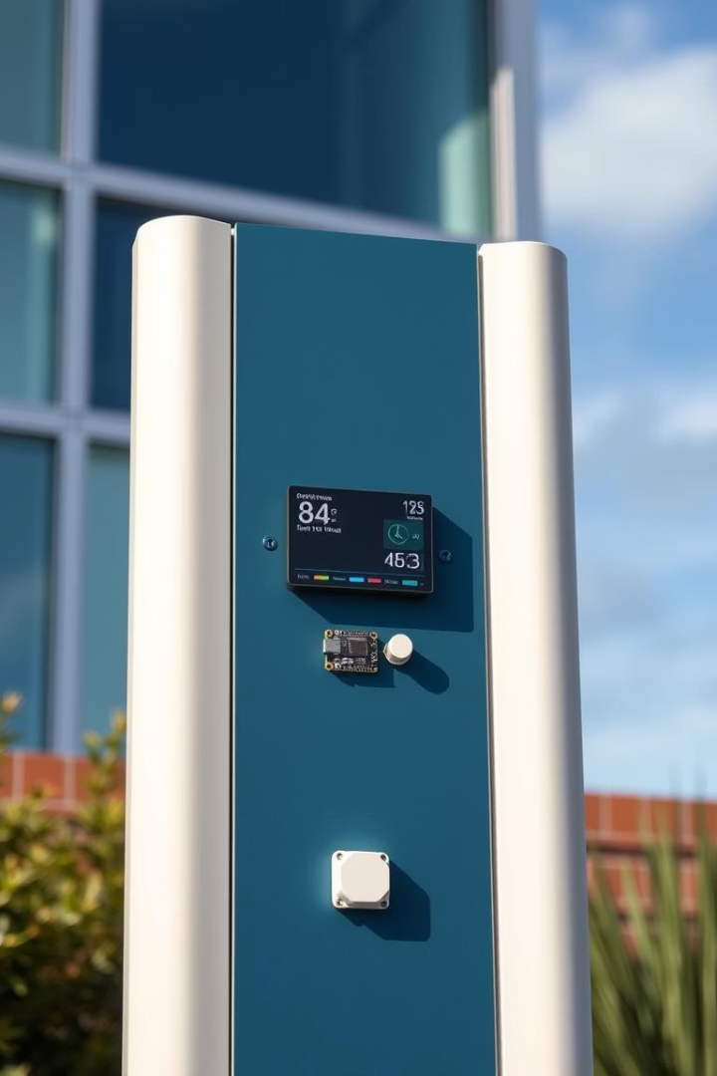
Smart Weather Station
Using Arduino Nano IoT 33 and BMP280 Sensor
Parampreet Singh
2410994851

Slide 2
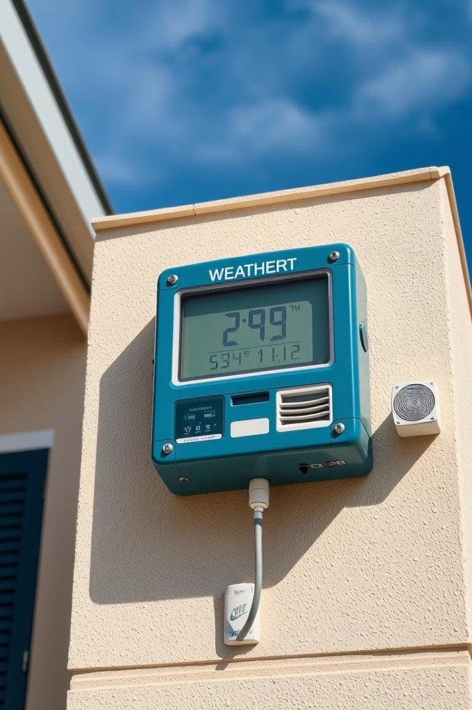
Problem Statement: Need for Localized Weather Data
Limited Local Precision
High Cost & Complexity
Current weather data provided by large networks often lacks the detail needed for hyperlocal conditions, impacting decision-making accuracy.
Existing professional weather stations are expensive and complicated to install, limiting access for small-scale users.
Real-Time Data Necessity
Real-time and precise weather updates are critical for agriculture, research, and automated systems relying on timely information.

Slide 3
Applications of Local Weather Data
Agriculture
Home Automation
Environmental Monitoring
Research
Local weather data helps optimize irrigation schedules and planting times, improving crop yields and resource efficiency.
HVAC systems adjust dynamically based on weather inputs, enhancing energy savings and comfortable indoor conditions.
Dense, low-cost sensor deployments enable detailed scientific observations across regions.
Microclimate variations can be tracked accurately, supporting ecological studies and pollution control efforts.

Slide 4
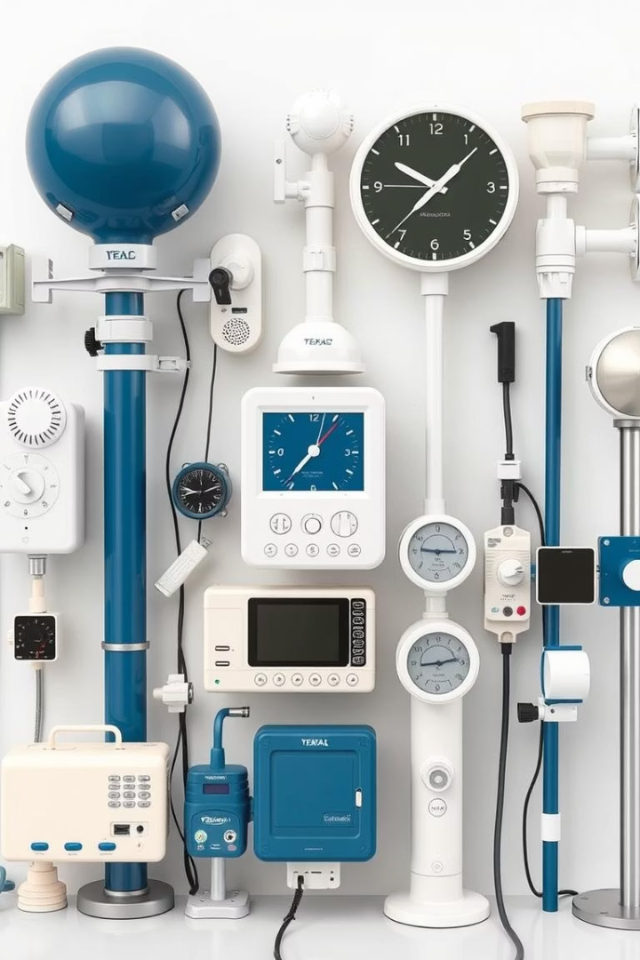



Existing Methods
Commercial Stations
Public Weather APIs
Highly reliable but costly and require technical expertise to install and maintain.
Offer convenient data but suffer from limited granularity and occasional accuracy issues for specific locales.
DIY Solutions
Affordable but often lack precision due to sensor quality and programming complexity barriers.

Slide 5
Proposed Methodology: System Overview
Arduino Nano IoT 33
BMP280 Sensor
Wireless Connectivity
Cloud Platform & Mobile App
Precision sensor measuring temperature and barometric pressure with high reliability and low power consumption.
Core microcontroller handling sensor data acquisition and wireless communication with cloud.
Utilizes Wi-Fi to transmit weather data seamlessly to a cloud platform for processing and storage.
Data visualization and historic weather trends delivered through an intuitive mobile interface.

Slide 6
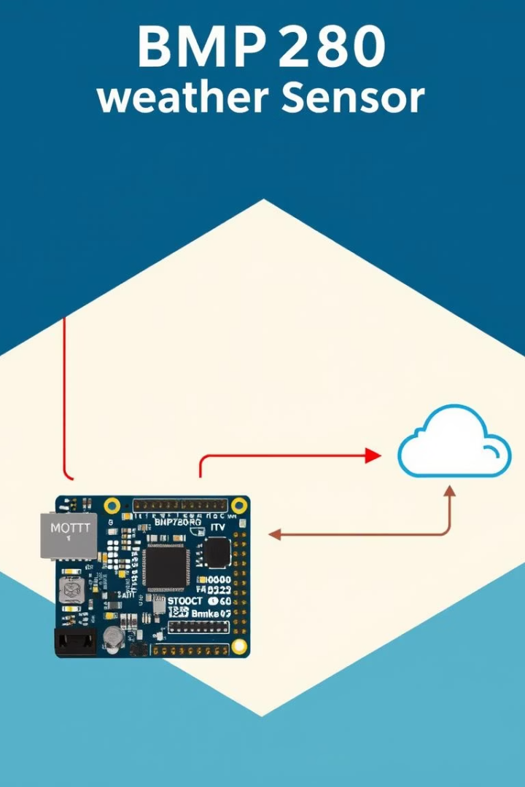
Data Acquisition and Processing
1
Sensor Sampling Rate
2
Data Transmission Protocol
BMP280 will capture readings every minute to provide timely updates without energy overuse.
MQTT protocol ensures efficient and reliable messaging between the device and cloud server.
3
Cloud Data Storage
Measurements stored in JSON format for easy querying and integration with visualization tools.

Slide 7
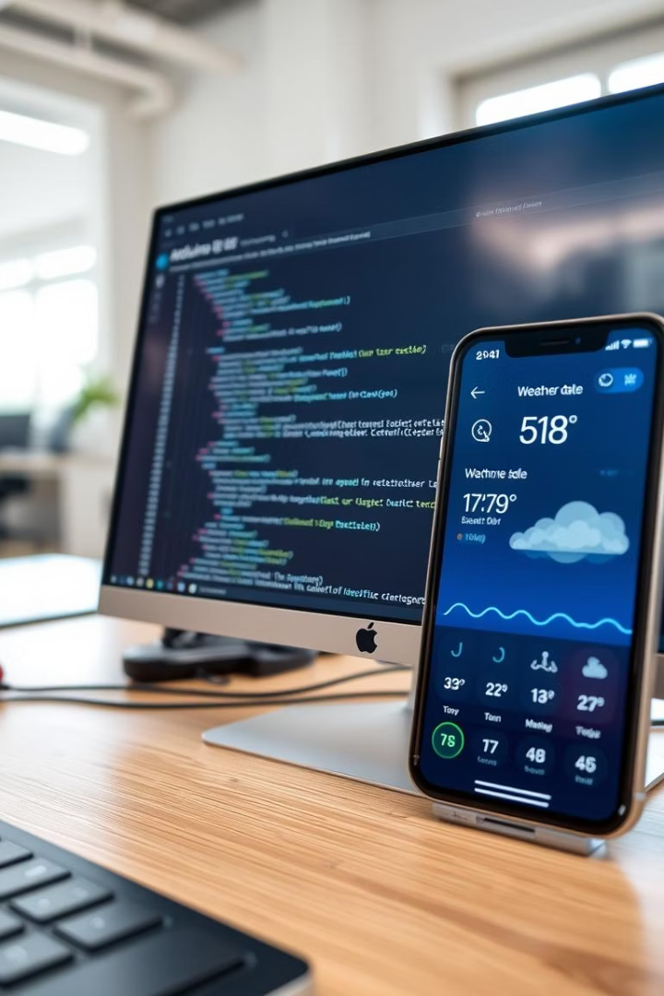
Software and Algorithms
Arduino Programming
Development using Arduino IDE to program data collection, sensor interaction, and MQTT communication.
Cloud Visualization
Use of dashboards to analyze trends, anomalies, and display real-time weather conditions.
Mobile App Interface
User-friendly app presenting current and historic weather data for end-users on the go.
Calibration Algorithm
Linear regression applied for sensor data correction improving accuracy against reference measurements.

Slide 8

Implementation Plan: Timeline and Milestones
1
Phase 1
Weeks 1-2: Hardware assembly and sensor calibration for accurate measurements.
2
Phase 2
Weeks 3-4: Software development including cloud integration and data workflow setup.
3
Phase 3
Weeks 5-6: Mobile application creation, testing, and deployment for user access.

Slide 9
Implementation Plan: Resources and Budget
Arduino Nano IoT 33: $35
Required Skills:
BMP280 Sensor: $10
- Embedded systems programming
Cloud Services: $5/month
- Cloud data management
Total Estimated Cost: Approx. $100 (including accessories)
- Mobile app development and UI design
- Data analysis and sensor calibration

Slide 10
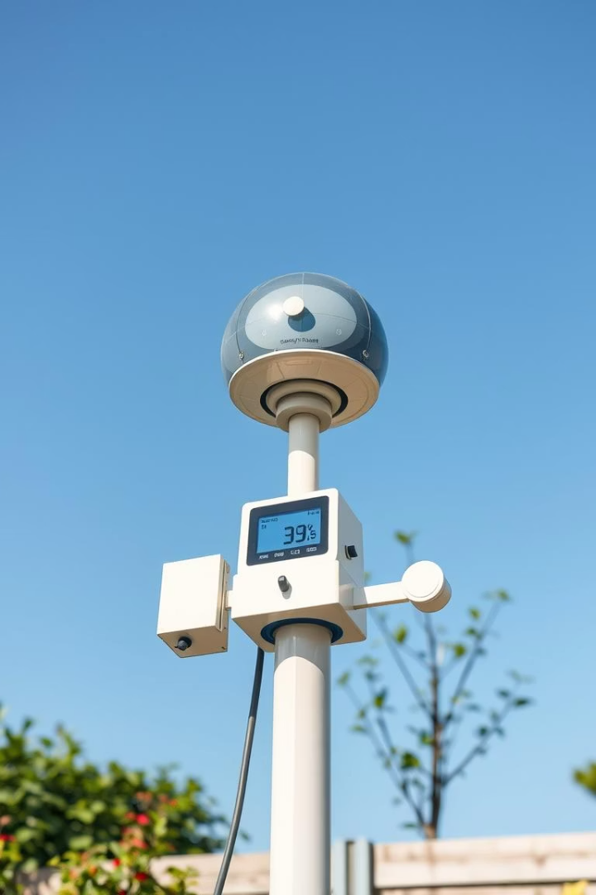
Conclusion
Affordable Accuracy
Diverse Applications
Delivering precise local weather data at low cost promotes accessibility and community benefit.
Supports agriculture, home automation, and scientific research with real-time localized information.
Scalability
Modular and open design allows for easy replication and deployment in various environments.

